Slide 1
Module-I
CSET333: Problem Solving Using C

Slide 2
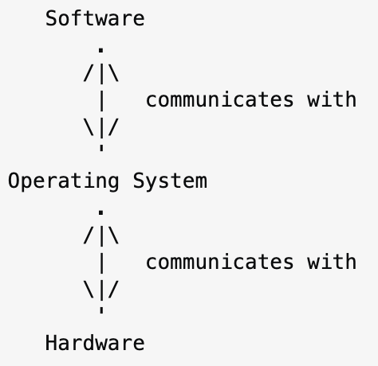
Communications with the Operating System
The operating system acts as a level of abstraction between software and hardware:
OS communicates with the hardware through programs called drivers.
OS communicates with software through procedures called system calls
CSET333: Problem Solving Using C

Slide 3
C Library Functions
In order to use these functions, we have to include the header file in the program. Below are some header files with descriptions:
Header Files | Description
<assert.h> | It checks the value of an expression that we expect to be true under normal circumstances. If the expression is a nonzero value, the assert macro does nothing.
<complex.h> | A set of functions for manipulating complex numbers.
<float.h> | Defines macro constants specifying the implementation-specific properties of the floating-point library.
<limits.h> | These limits specify that a variable cannot store any value beyond these limits, for example- An unsigned character can store up to a maximum value of 255.
CSET333: Problem Solving Using C

Slide 4
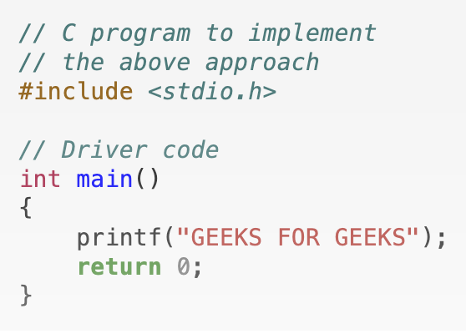
Header Files | Description
<math.h> | The math.h header defines various mathematical functions and one macro. All the Functions in this library take double as an argument and return double as the result.
<stdio.h> | The stdio.h header defines three variable types, several macros, and various function for performing input and output.
<time.h> | Defines date and time handling functions.
<string.h> | Strings are defined as an array of characters. The difference between a character array and a string is that a string is terminated with a special character ‘\0’.
Example:
CSET333: Problem Solving Using C

Slide 5
Preprocessor Directives in C
Preprocessor programs provide preprocessor directives that tell the compiler to preprocess the source code before compiling.
All of these preprocessor directives begin with a ‘#’ (hash) symbol.
The ‘#’ symbol indicates that whatever statement starts with a ‘#’ will go to the preprocessor program to get executed.
We can place these preprocessor directives anywhere in our program.
Examples of some preprocessor directives are:
#include, #define, #ifndef, etc.
Note: Remember that the # symbol only provides a path to the preprocessor, and a command such as include is processed by the preprocessor program.
For example, #include will include the code or content of the specified file in your program.
CSET333: Problem Solving Using C

Slide 6
List of preprocessor directives in C
The following table lists all the preprocessor directives in C:
Preprocessor Directives | Description
#define | Used to define a macro
#undef | Used to undefine a macro
#include | Used to include a file in the source code program
#ifdef | Used to include a section of code if a certain macro is defined by #define
#ifndef | Used to include a section of code if a certain macro is not defined by #define
#if | Check for the specified condition
#else | Alternate code that executes when #if fails
#elif | Combines else and if for another condition check
#endif | Used to mark the end of #if, #ifdef, and #ifndef
CSET333: Problem Solving Using C

Slide 7
Debugging and Efficiency
Why debugging??
  To detect, analyse, and correct mistakes in a systematic way.
Debugging begins with reproducing the error.
When the error can be reproduced, the next step is to identify the cause of the problem.
Logical errors, on the other hand, require a thorough examination of the code.
Debugging in C is the process of locating and fixing mistakes, bugs, and other problems in a C program.
It involves detecting and correcting logical, syntactic, and runtime issues to guarantee the program works correctly.
Efficiency
Use asymptotic notations to analyse time and space complexity of a given program
CSET333: Problem Solving Using C

Slide 8
C Memory Models:
Memory Layout:
- The memory in a C program is typically divided into several segments:
  Text Segment: Contains the compiled code.
  Data Segment: Holds global and static variables.
  Heap: Used for dynamic memory allocation (managed via malloc, free, etc.).
  Stack: Used for function call management, local variables, and control flow.
CSET333: Problem Solving Using C

Slide 9
Data Types in C
Properties of Data Types:
Each variable in C has an associated data type.
It specifies the type of data that the variable can store like integer, character, floating, double, etc.
Each data type requires different amounts of memory and has some specific operations which can be performed over it.
The data type is a collection of data with values having fixed values, meaning as well as its characteristics.
CSET333: Problem Solving Using C

Slide 10
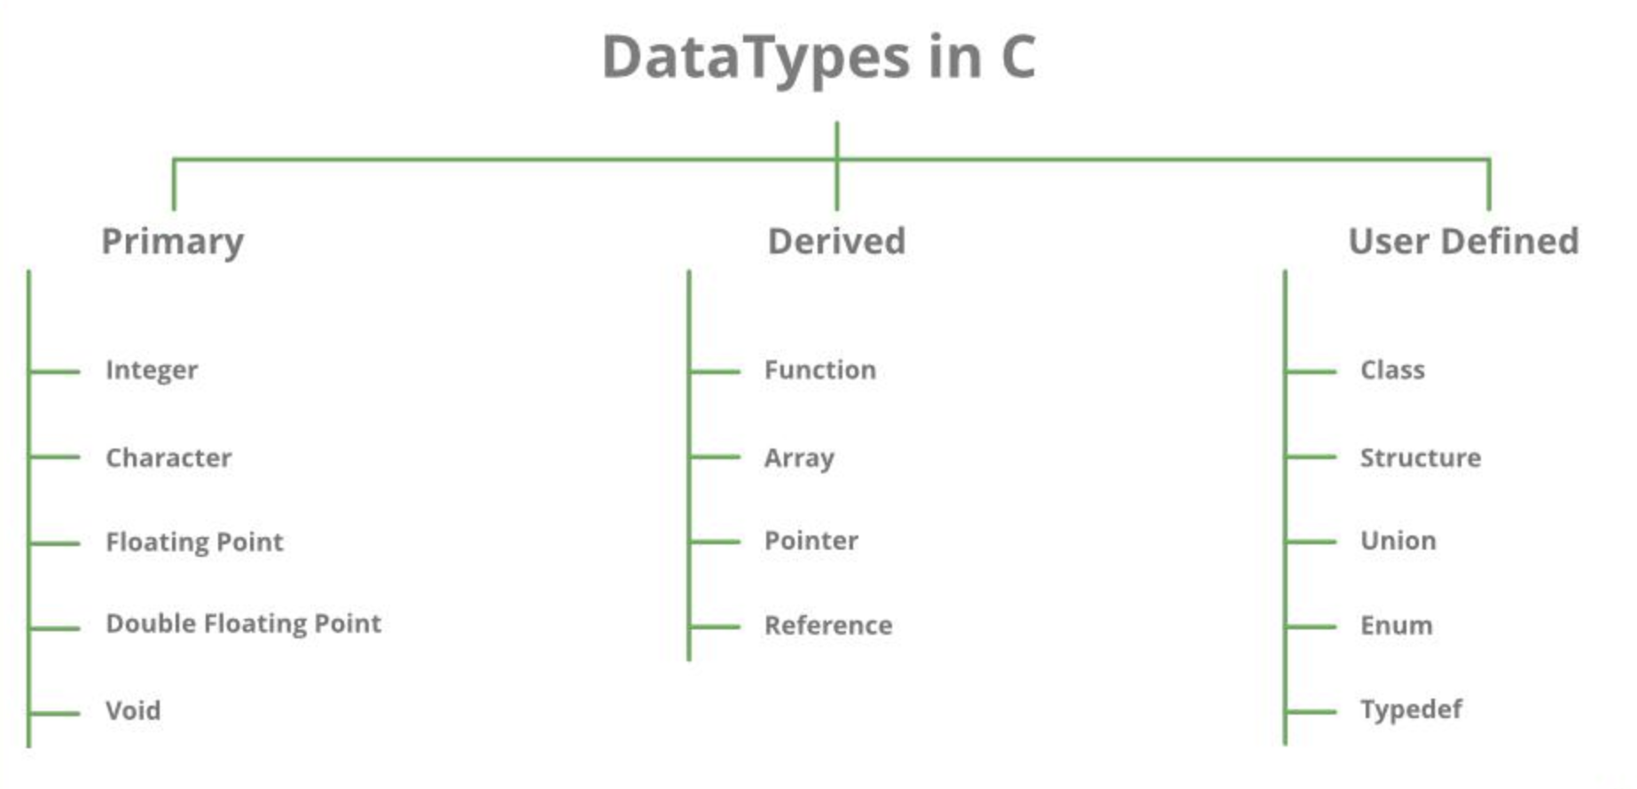
Types | Description
Primitive Data Types | Primitive data types are the most basic data types that are used for representing simple values such as integers, float, characters, etc.
User Defined Data Types | The user-defined data types are defined by the user himself.
Derived Types | The data types that are derived from the primitive or built-in datatypes are referred to as Derived Data Types.
CSET333: Problem Solving Using C

Slide 11
Integer Data Type
  Integers are stored in various sizes. They can be signed or unsigned.
  Example
  Suppose an integer is represented by a byte (8 bits). Leftmost bit is sign bit. If the sign bit is 0, the number is treated as positive.
  Bit pattern 01001011 = 75 (decimal).
  The largest positive number is 01111111 = 2⁷ – 1 = 127.
  Negative numbers are stored as two’s complement or as one’s complement.
  -75 = 10110100 (one’s complement).
  -75 = 10110101 (two’s complement).
CSET333: Problem Solving Using C

Slide 12
Data Type | Size (bytes) | Range | Format Specifier
short int | 2 | -32,768 to 32,767 | %hd
unsigned short int | 2 | 0 to 65,535 | %hu
unsigned int | 4 | 0 to 4,294,967,295 | %u
int | 4 | -2,147,483,648 to 2,147,483,647 | %d
long int | 4 | -2,147,483,648 to 2,147,483,647 | %ld
unsigned long int | 4 | 0 to 4,294,967,295 | %lu
long long int | 8 | -(2^63) to (2^63)-1 | %lld
CSET333: Problem Solving Using C

Slide 13
Data Type | Size (bytes) | Range | Format Specifier
unsigned long long int | 8 | 0 to 18,446,744,073,709,551,615 | %llu
signed char | 1 | -128 to 127 | %c
unsigned char | 1 | 0 to 255 | %c
float | 4 | 1.2E-38 to 3.4E+38 | %f
double | 8 | 1.7E-308 to 1.7E+308 | %lf
long double | 16 | 3.4E-4932 to 1.1E+4932 | %Lf
unsigned long long int | 8 | 0 to 18,446,744,073,709,551,615 | %llu
CSET333: Problem Solving Using C

Slide 14
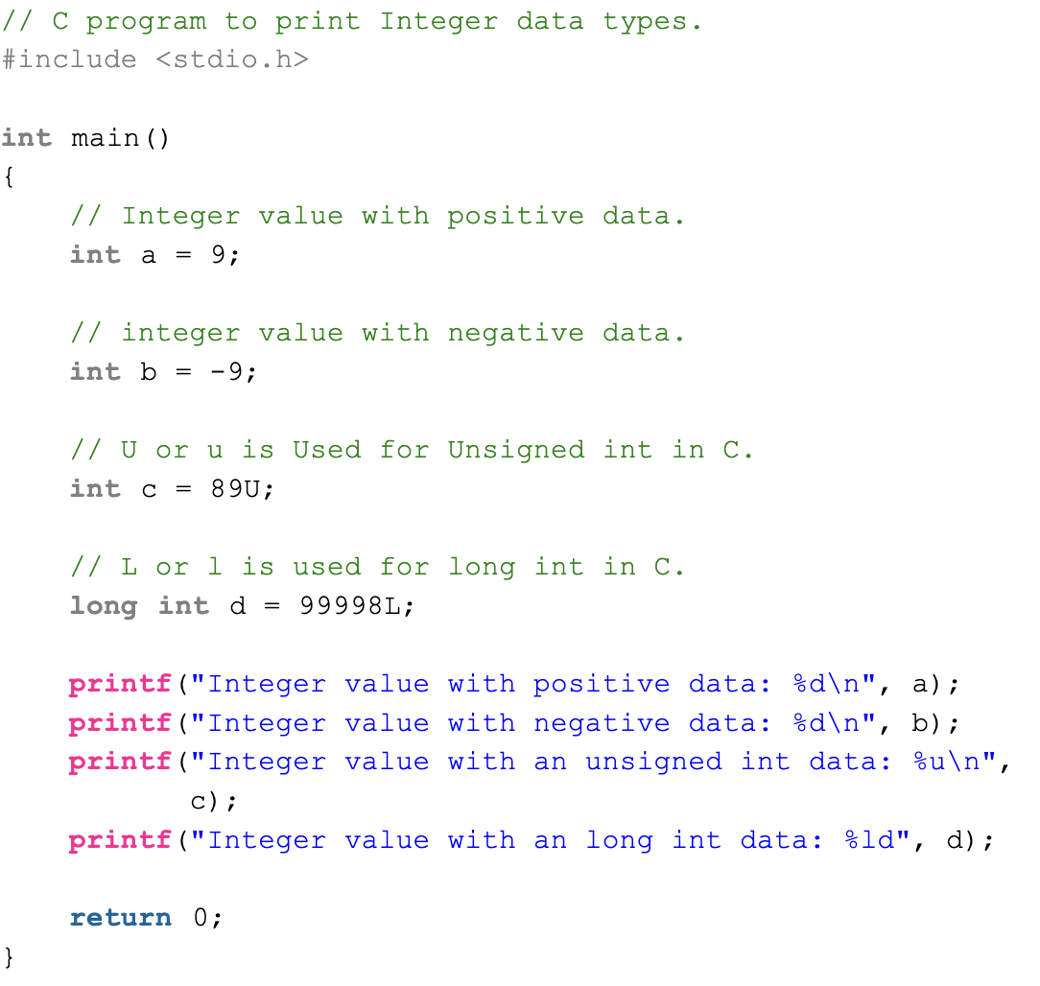
Example:
CSET333: Problem Solving Using C

Slide 15
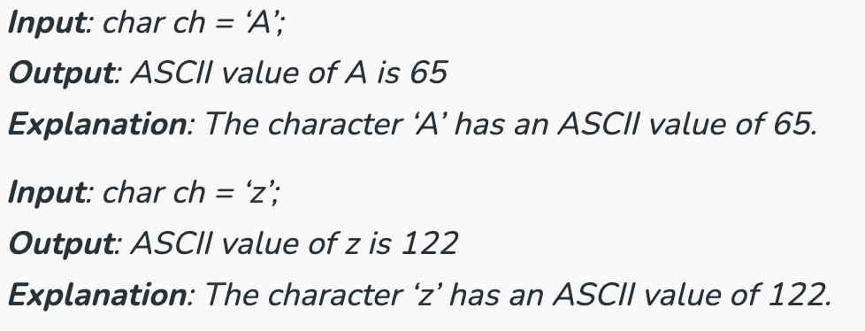
ASCII Value of a Character in C
Each character or special character is represented by some ASCII code.
Each ASCII code occupies 7 bits in memory.
Each character variable is assigned an ASCII value ranging from 0 to 127.
Example:
CSET333: Problem Solving Using C

Slide 16
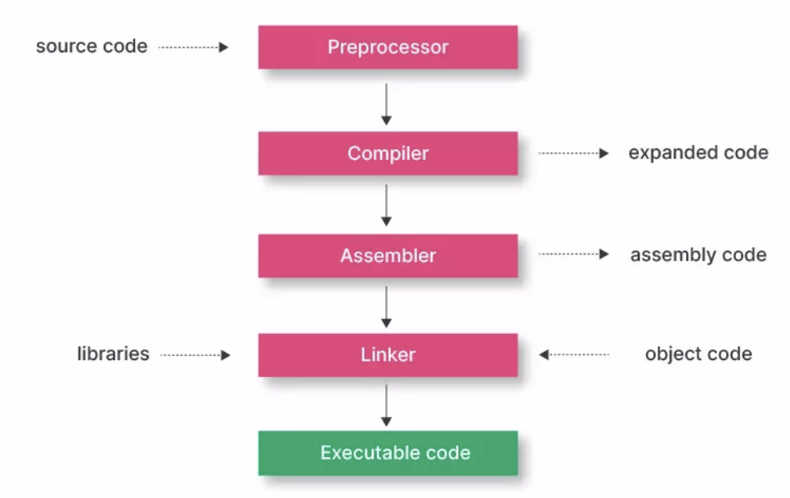
Compilation and Linking Process in C
The modified source code is compiled into binary object code. This code is not yet executable.
CSET333: Problem Solving Using C

Slide 17
Types of compilers
There are four different Compilers:
Cross-Compiler – The compiled program can run on a computer whose CPU or Operating System is different from the one on which the compiler runs.
Bootstrap Compiler – The compiler written in the language that it intends to compile.
Decompiler – The compiler that translates from a low-level language to a higher level one.
Transcompiler – The compiler that translates high level languages.
CSET333: Problem Solving Using C

Slide 18
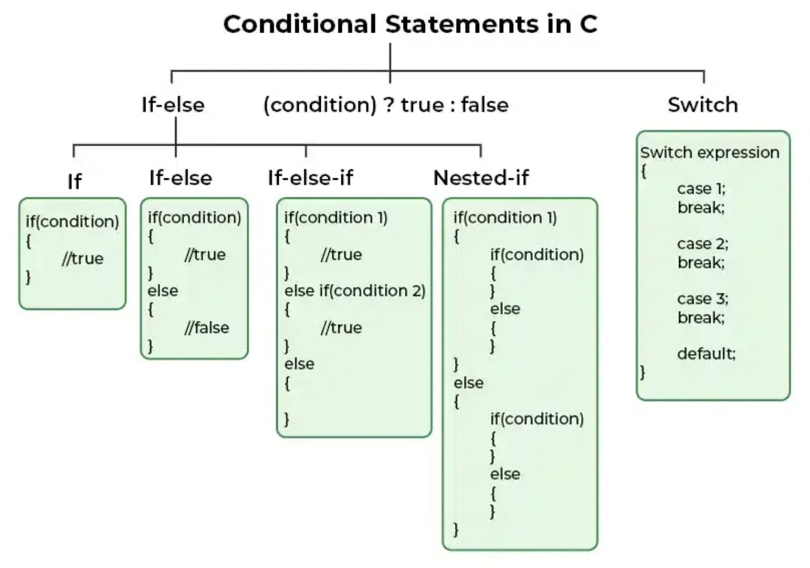
Decision Making in C
CSET333: Problem Solving Using C

Slide 19
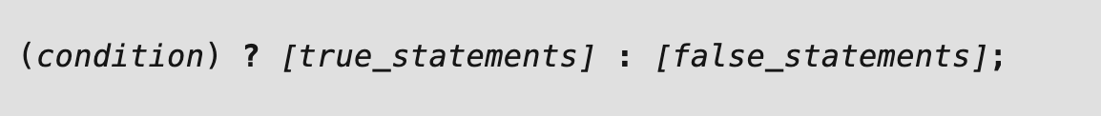
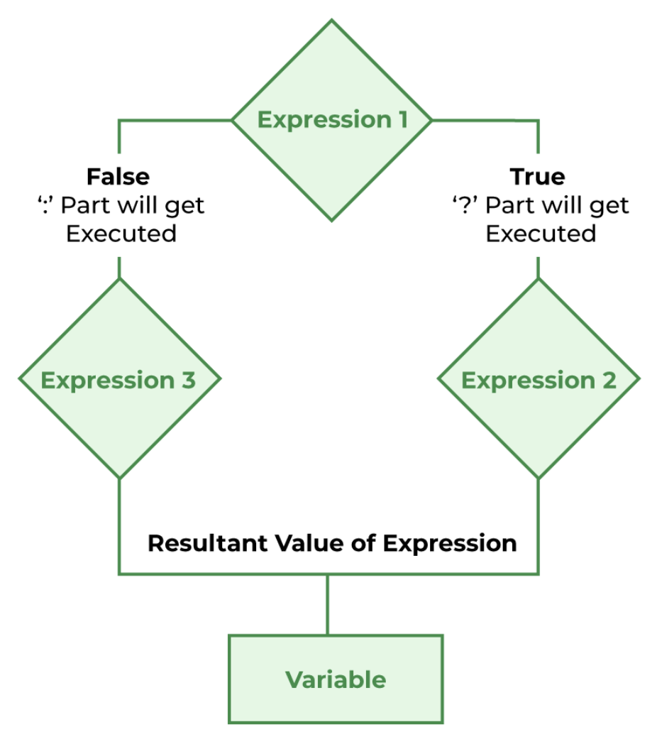
Conditional Operator in C
Syntax of Conditional Operator
Flowchart of
Conditional Operator
CSET333: Problem Solving Using C

Slide 20
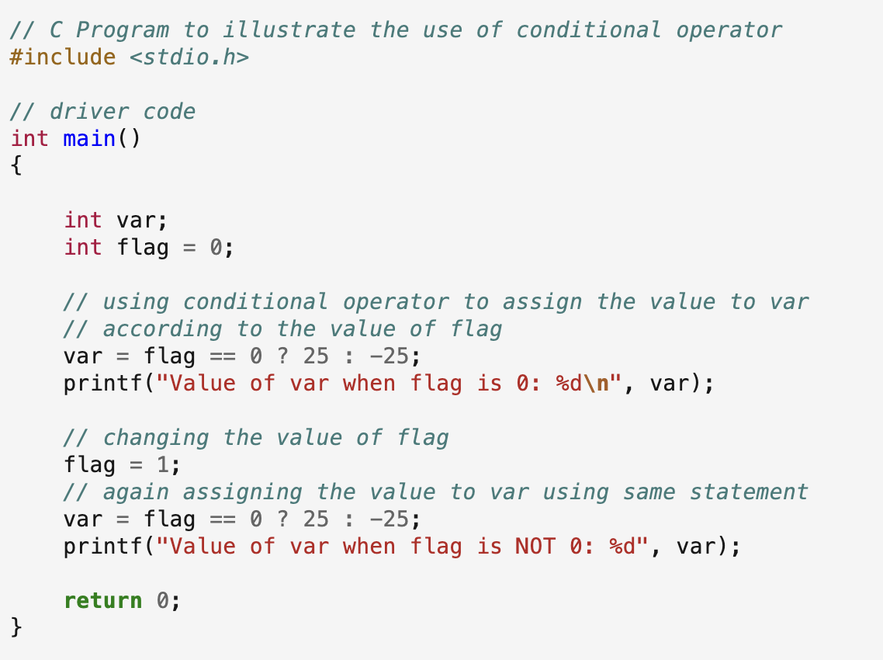
CSET333: Problem Solving Using C

Slide 21
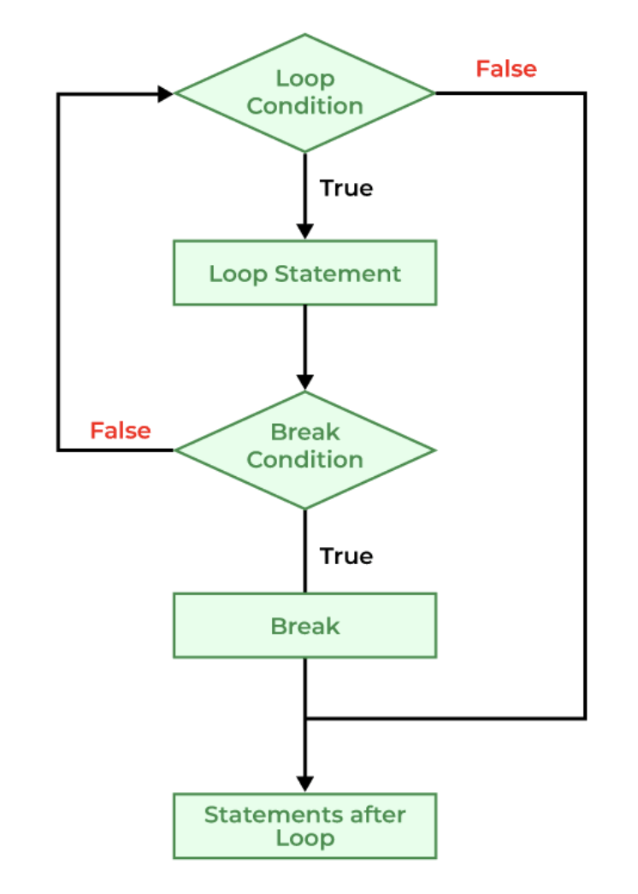

Jump Statements in C
1. break
Syntax of break
Flowchart of beak
CSET333: Problem Solving Using C

Slide 22
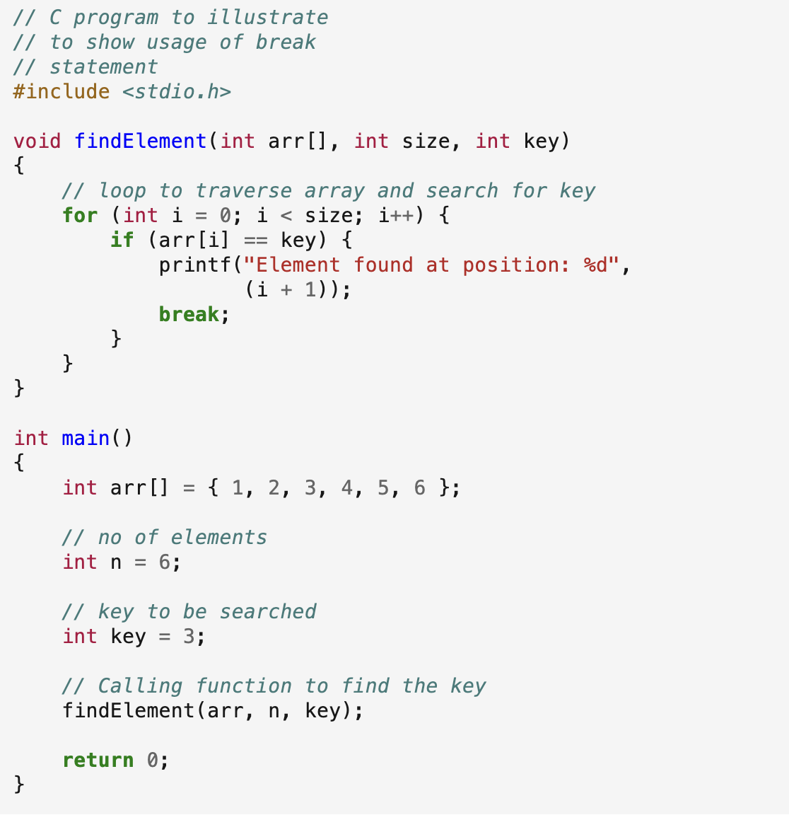
Output: Element found at position: 3
CSET333: Problem Solving Using C

Slide 23

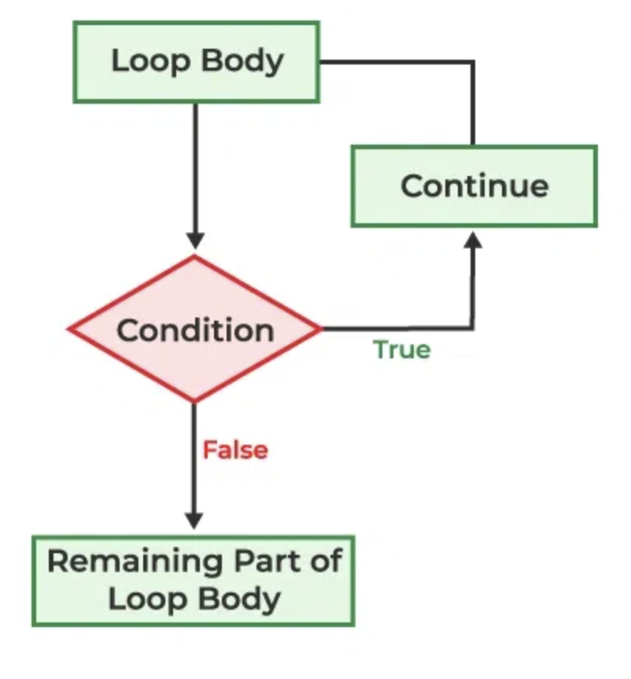
B) continue
Syntax of continue
Flowchart of continue
CSET333: Problem Solving Using C

Slide 24
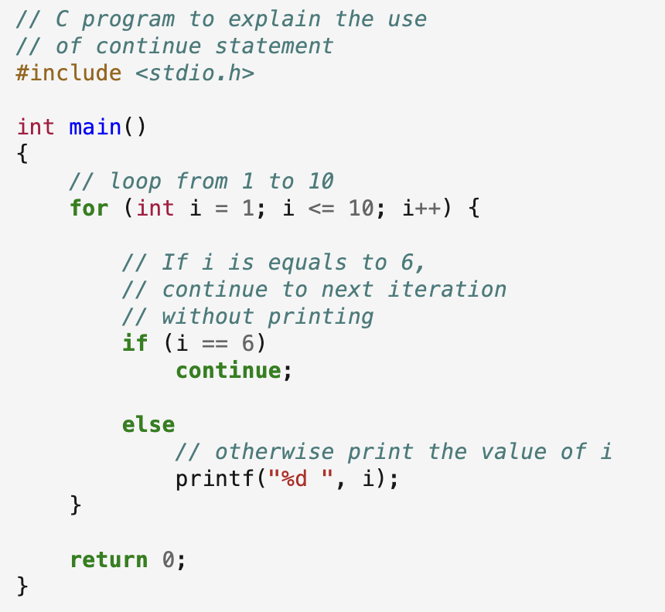
Output: 1 2 3 4 5 7 8 9 10
CSET333: Problem Solving Using C

Slide 25
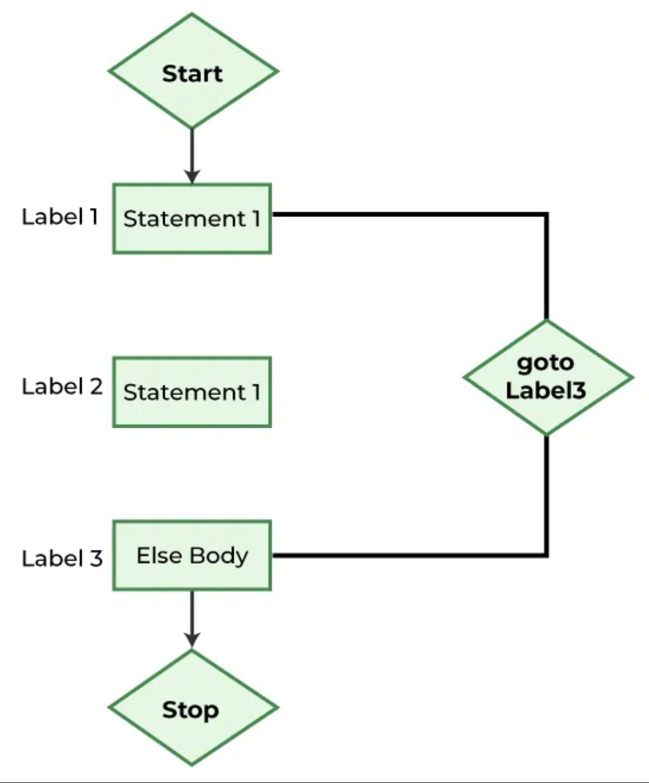
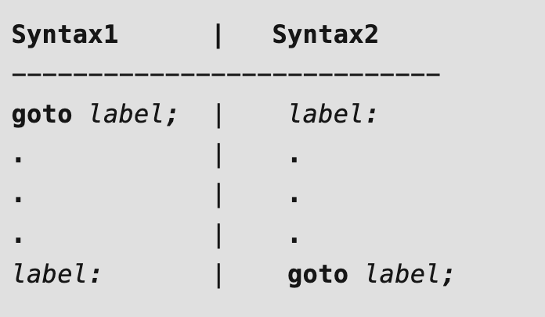
C) goto
Syntax of goto
Flowchart of goto
CSET333: Problem Solving Using C

Slide 26
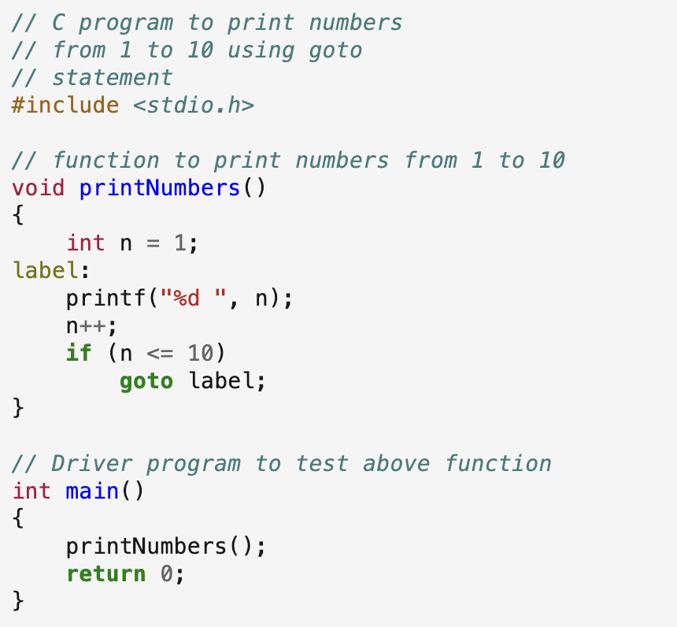
Output: 1 2 3 4 5 6 7 8 9 10
CSET333: Problem Solving Using C

Slide 27
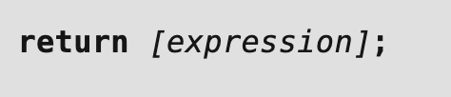
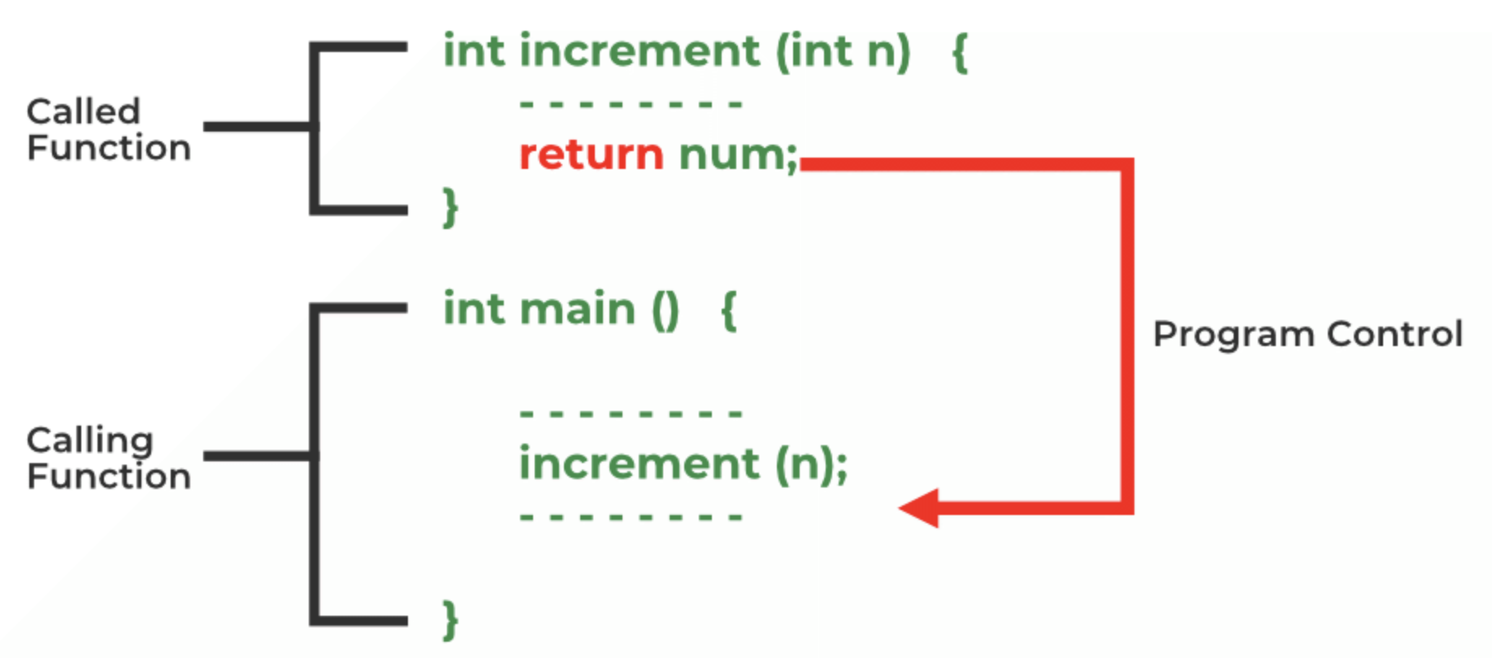
D) return
Syntax of return
Flowchart of return
CSET333: Problem Solving Using C

Slide 28
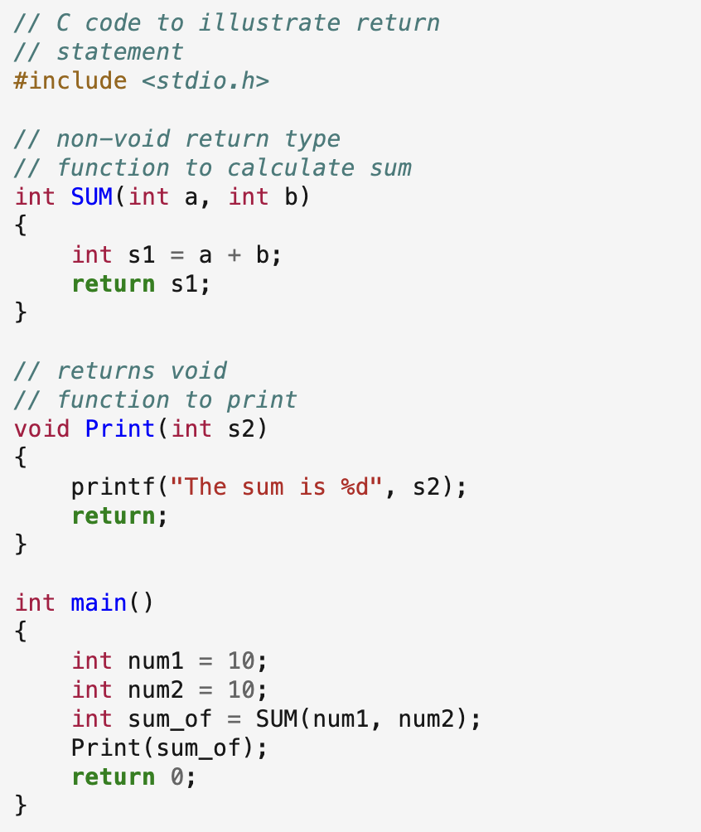
Output: The sum is 20
CSET333: Problem Solving Using C

Slide 29
Null Statement in C
Syntax:
;
What is the purpose of null statement?
do nothing
Example 1:
for (i = 0; i < 5; i++)
; // null statement
Here, the body of the for loop is null statement.
Example 2:
goto label;
........
label:
;
CSET333: Problem Solving Using C

Slide 30
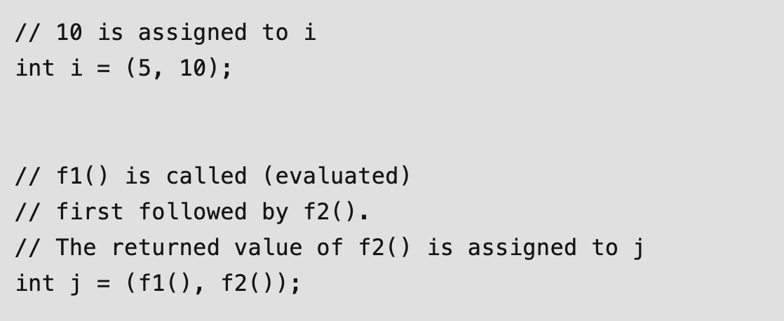
Comma operator in C
A comma operator is a binary operator.
It evaluates the first operand & discards the result, evaluates the second operand & returns the value as a result.
CSET333: Problem Solving Using C

Slide 31
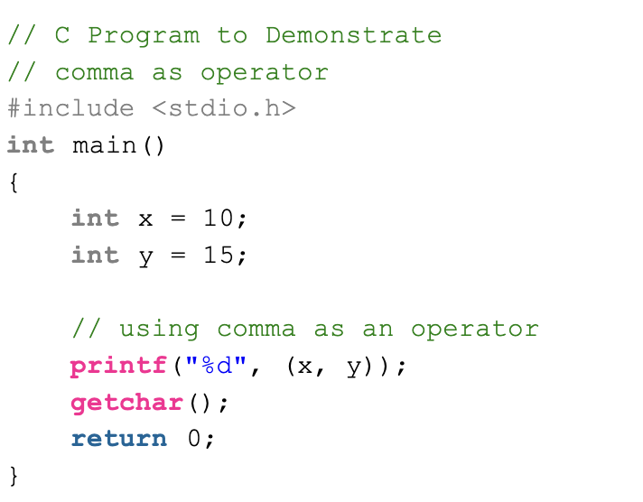
Output: 15
CSET333: Problem Solving Using C

Slide 32
setjump and longjump in C
“Setjump” and “Longjump” are defined in setjmp.h, a header file in C standard library.
setjump(jmp_buf buf) : uses buf to remember the current position and returns 0.
longjump(jmp_buf buf, i) : Go back to the place buf is pointing to and return i.
CSET333: Problem Solving Using C

Slide 33
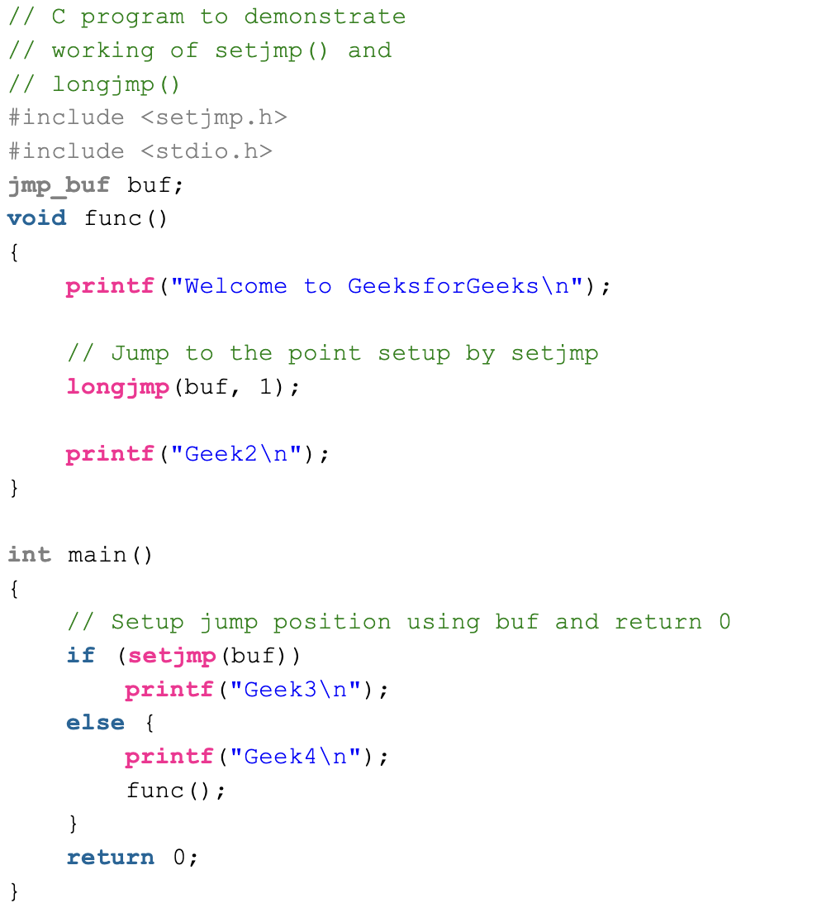
Output:
Geek4
Welcome to GeeksforGeeks
Geek3
CSET333: Problem Solving Using C

Slide 34
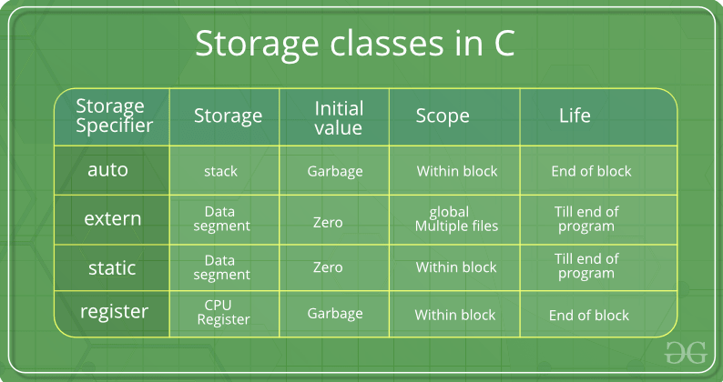
Storage Classes in C
C Storage Classes are used to describe the features of a variable/function. These features basically include the scope, visibility, and lifetime which help us to trace the existence of a particular variable during the runtime of a program.
C language uses 4 storage classes, namely:
CSET333: Problem Solving Using C

Slide 35
1. auto
This is the default storage class for all the variables declared inside a function or a block. Hence, the keyword auto is rarely used while writing programs in C language.
Auto variables can be only accessed within the block/function they have been declared and not outside them (which defines their scope).
Of course, these can be accessed within nested blocks within the parent block/function in which the auto variable was declared.
However, they can be accessed outside their scope as well using the concept of pointers given here by pointing to the very exact memory location where the variables reside.
They are assigned a garbage value by default whenever they are declared.
CSET333: Problem Solving Using C

Slide 36
2. extern
Extern storage class simply tells us that the variable is defined elsewhere and not within the same block where it is used.
Basically, the value is assigned to it in a different block and this can be overwritten/changed in a different block as well.
So an extern variable is nothing but a global variable initialized with a legal value where it is declared in order to be used elsewhere. It can be accessed within any function/block.
Also, a normal global variable can be made extern as well by placing the ‘extern’ keyword before its declaration/definition in any function/block.
This basically signifies that we are not initializing a new variable but instead, we are using/accessing the global variable only.
The main purpose of using extern variables is that they can be accessed between two different files which are part of a large program.
CSET333: Problem Solving Using C

Slide 37
3. static
This storage class is used to declare static variables which are popularly used while writing programs in C language.
Static variables have the property of preserving their value even after they are out of their scope!
Hence, static variables preserve the value of their last use in their scope.
So we can say that they are initialized only once and exist till the termination of the program.
Thus, no new memory is allocated because they are not re-declared.
Their scope is local to the function to which they were defined.
Global static variables can be accessed anywhere in the program. By default, they are assigned the value 0 by the compiler.
CSET333: Problem Solving Using C

Slide 38
4. register
This storage class declares register variables that have the same functionality as that of the auto variables.
The only difference is that the compiler tries to store these variables in the register of the microprocessor if a free register is available.
This makes the use of register variables to be much faster than that of the variables stored in the memory during the runtime of the program.
If a free registration is not available, these are then stored in the memory only.
Usually, a few variables which are to be accessed very frequently in a program are declared with the register keyword which improves the running time of the program.
An important and interesting point to be noted here is that we cannot obtain the address of a register variable using pointers.
CSET333: Problem Solving Using C

Slide 39
Syntax
To specify the storage class for a variable, the following syntax is to be followed:
storage_class var_data_type var_name;
Example:
auto int a = 32;
register char b = 'G’;
extern int x;
CSET333: Problem Solving Using C

Slide 40
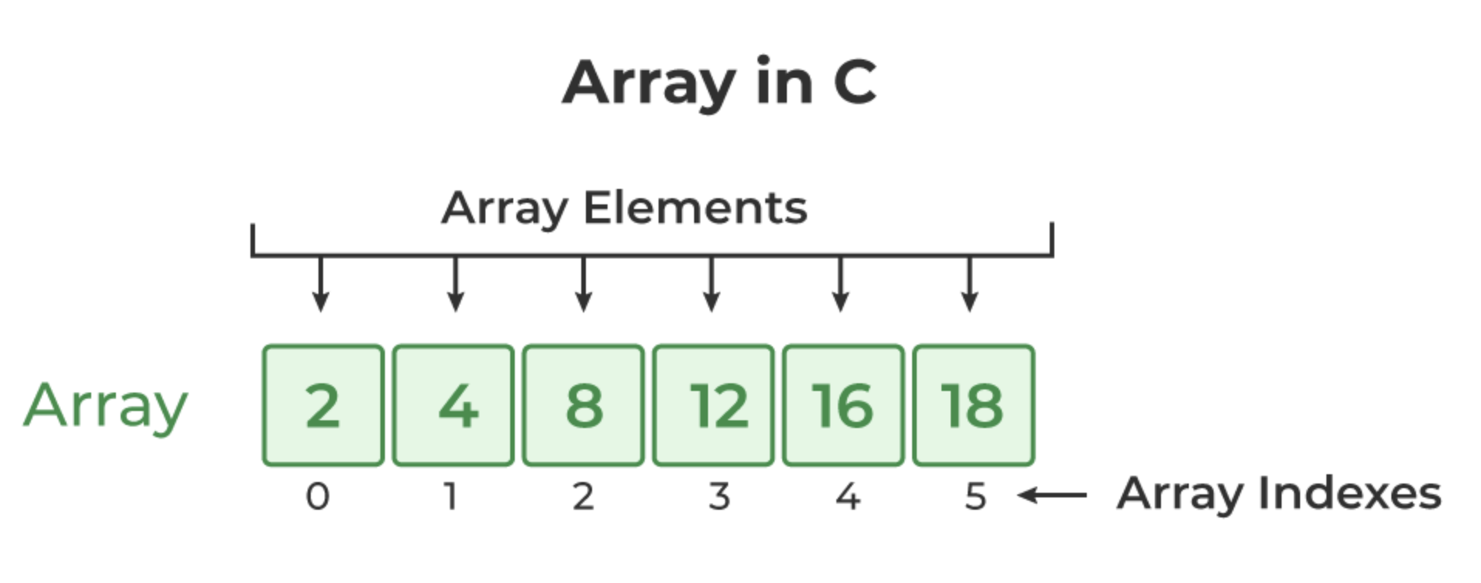
C Arrays
What is Array in C?
An array in C is a fixed-size collection of similar data items stored in contiguous memory locations.
It can be used to store the collection of primitive data types such as int, char, float, etc., and also derived and user-defined data types such as pointers, structures, etc.
CSET333: Problem Solving Using C

Slide 41
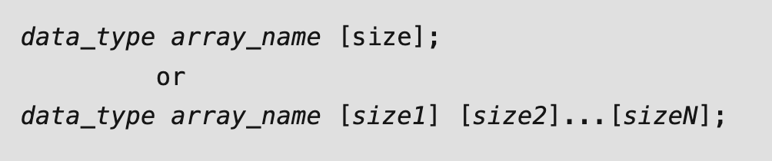
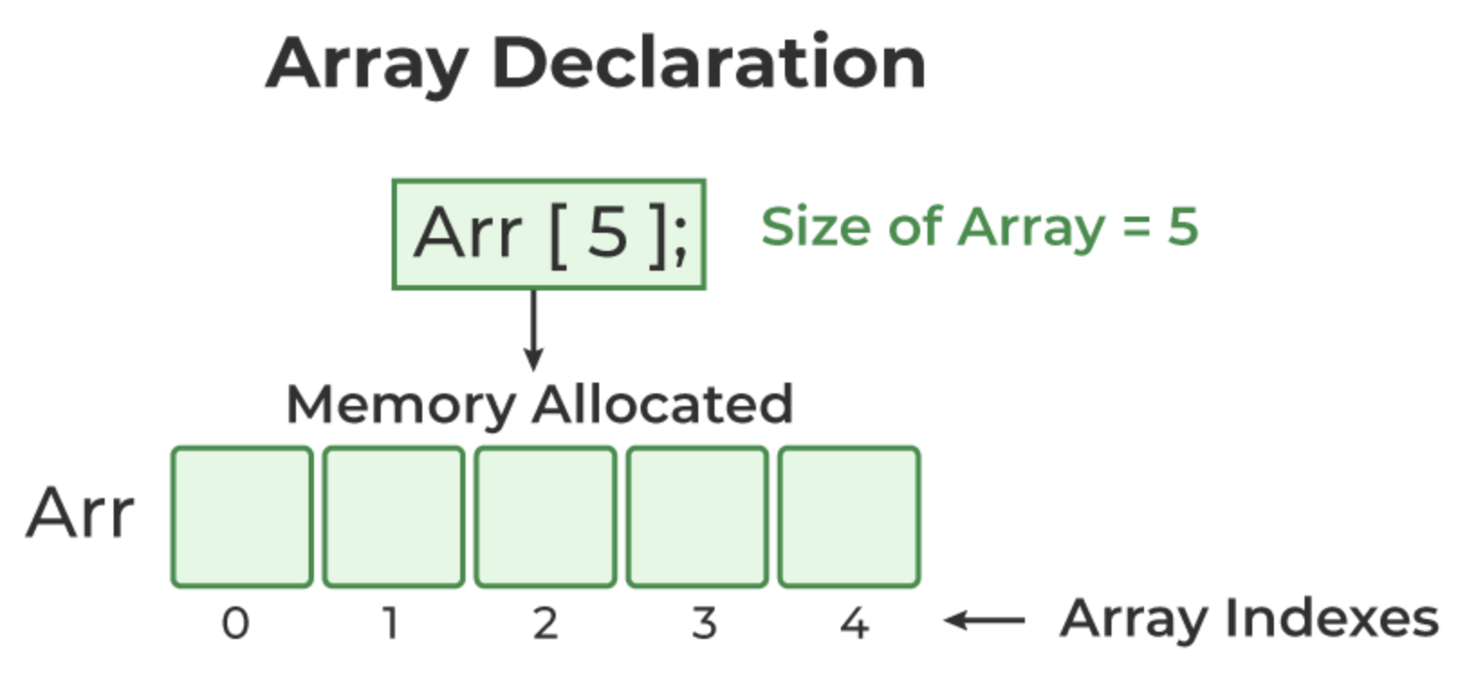
C Array Declaration
Syntax of Array Declaration
where N is the number of dimensions.
CSET333: Problem Solving Using C

Slide 42
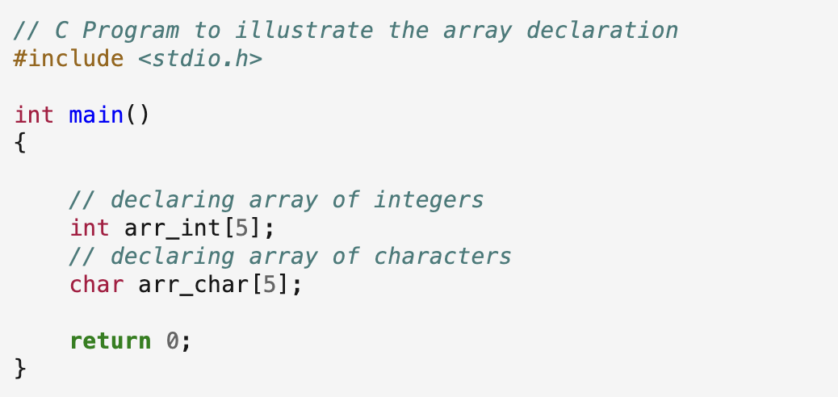
Example:
CSET333: Problem Solving Using C

Slide 43
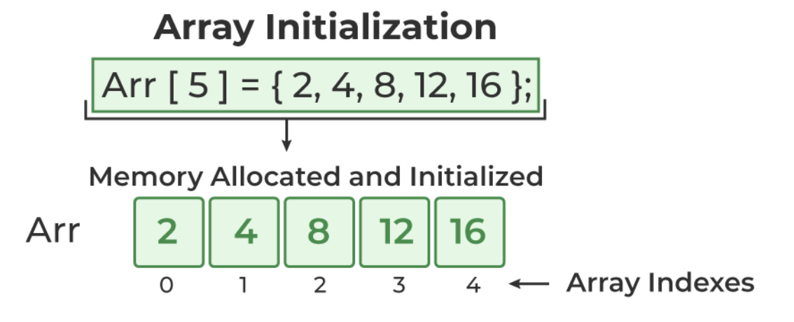
C Array Initialization
1. Array Initialization with Declaration
In this method, we initialize the array along with its declaration.
We use an initializer list to initialize multiple elements of the array.
An initializer list is the list of values enclosed within braces {} separated b a comma.
CSET333: Problem Solving Using C

Slide 44

2. Array Initialization with Declaration without Size
If we initialize an array using an initializer list, we can skip declaring the size of the array as the compiler can automatically deduce the size of the array in these cases.
The size of the array in these cases is equal to the number of elements present in the initializer list as the compiler can automatically deduce the size of the array.
The size of the above arrays is 5 which is automatically deduced by the compiler.
CSET333: Problem Solving Using C

Slide 45
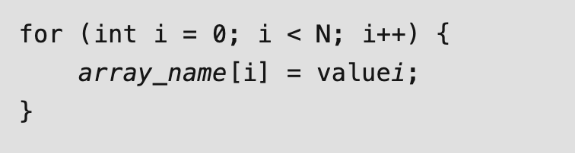
3. Array Initialization after Declaration (Using Loops)
We initialize the array after the declaration by assigning the initial value to each element individually. We can use for loop, while loop, or do-while loop to assign the value to each element of the array.
CSET333: Problem Solving Using C

Slide 46

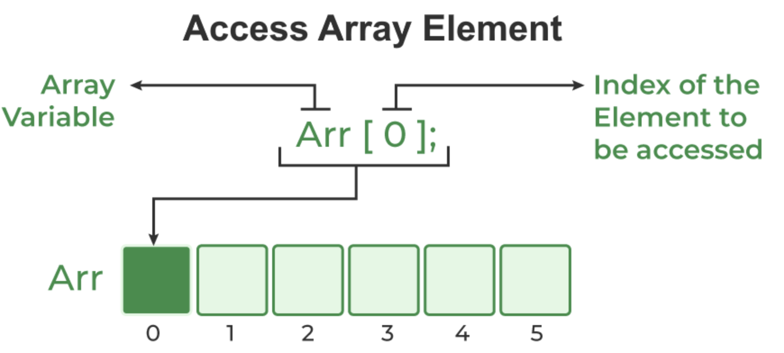
Access Array Elements
We can access any element of an array in C using the array subscript operator [ ] and the index value i of the element.
One thing to note is that the indexing in the array always starts with 0, i.e., the first element is at index 0 and the last element is at N – 1 where N is the number of elements in the array.
CSET333: Problem Solving Using C

Slide 47
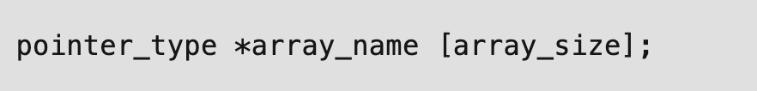
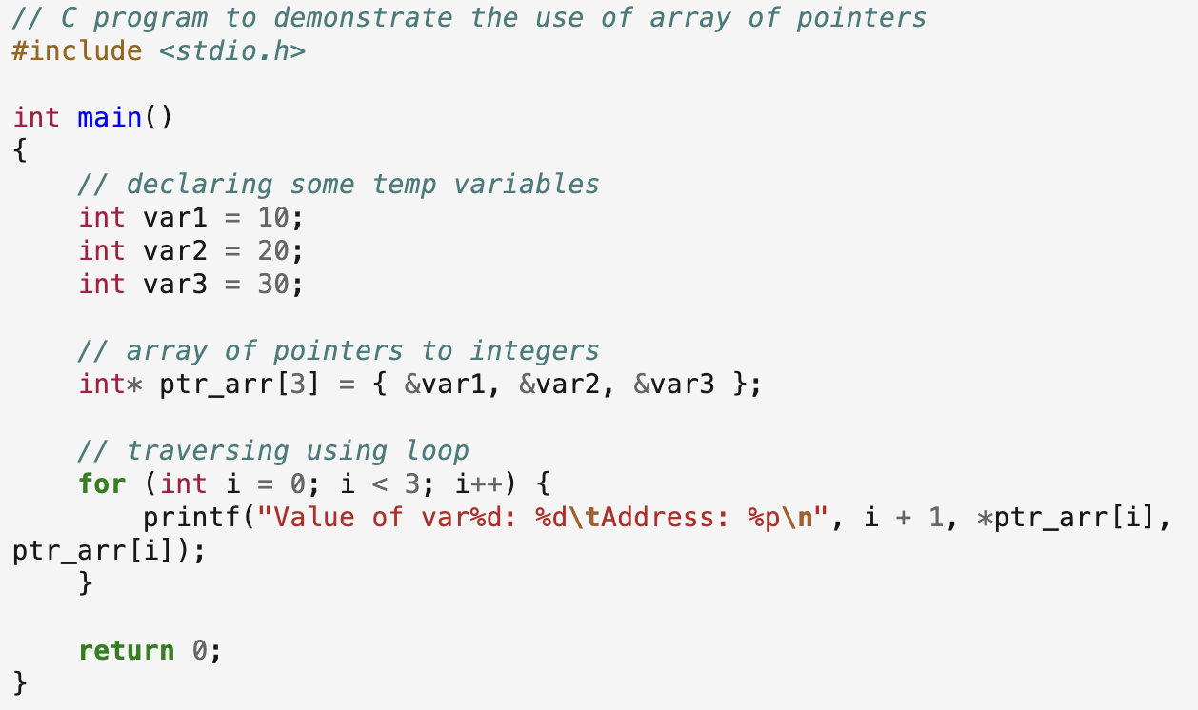
Array of Pointers in C
Syntax:
Here,
  pointer_type: Type of data the pointer is pointing to.
  array_name: Name of the array of pointers.
  array_size: Size of the array of pointers.
CSET333: Problem Solving Using C

Slide 48
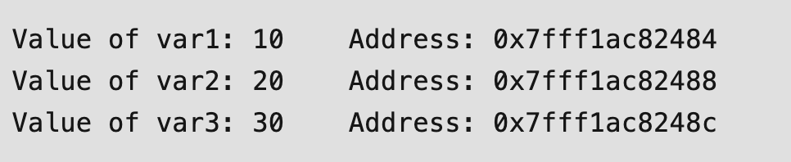
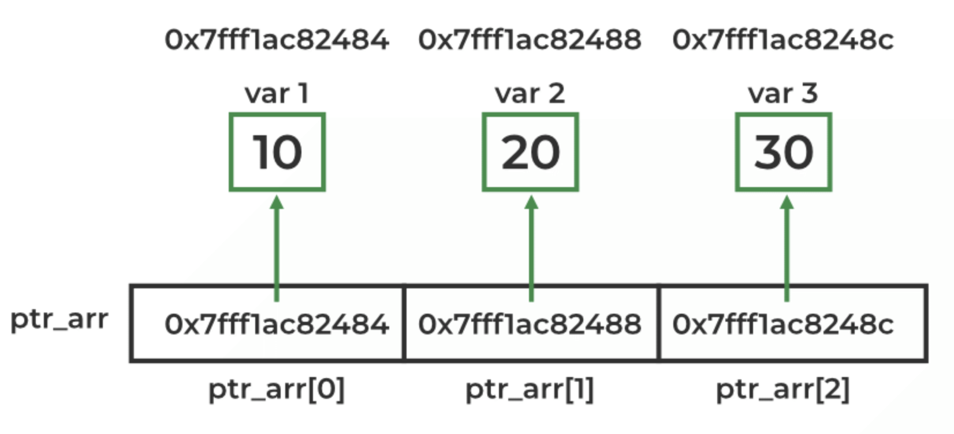
Output:
CSET333: Problem Solving Using C

Slide 49

Array of Pointers to Character
One of the main applications of the array of pointers is to store multiple strings as an array of pointers to characters.
Here, each pointer in the array is a character pointer that points to the first character of the string.
Syntax:
Example:
CSET333: Problem Solving Using C

Slide 50
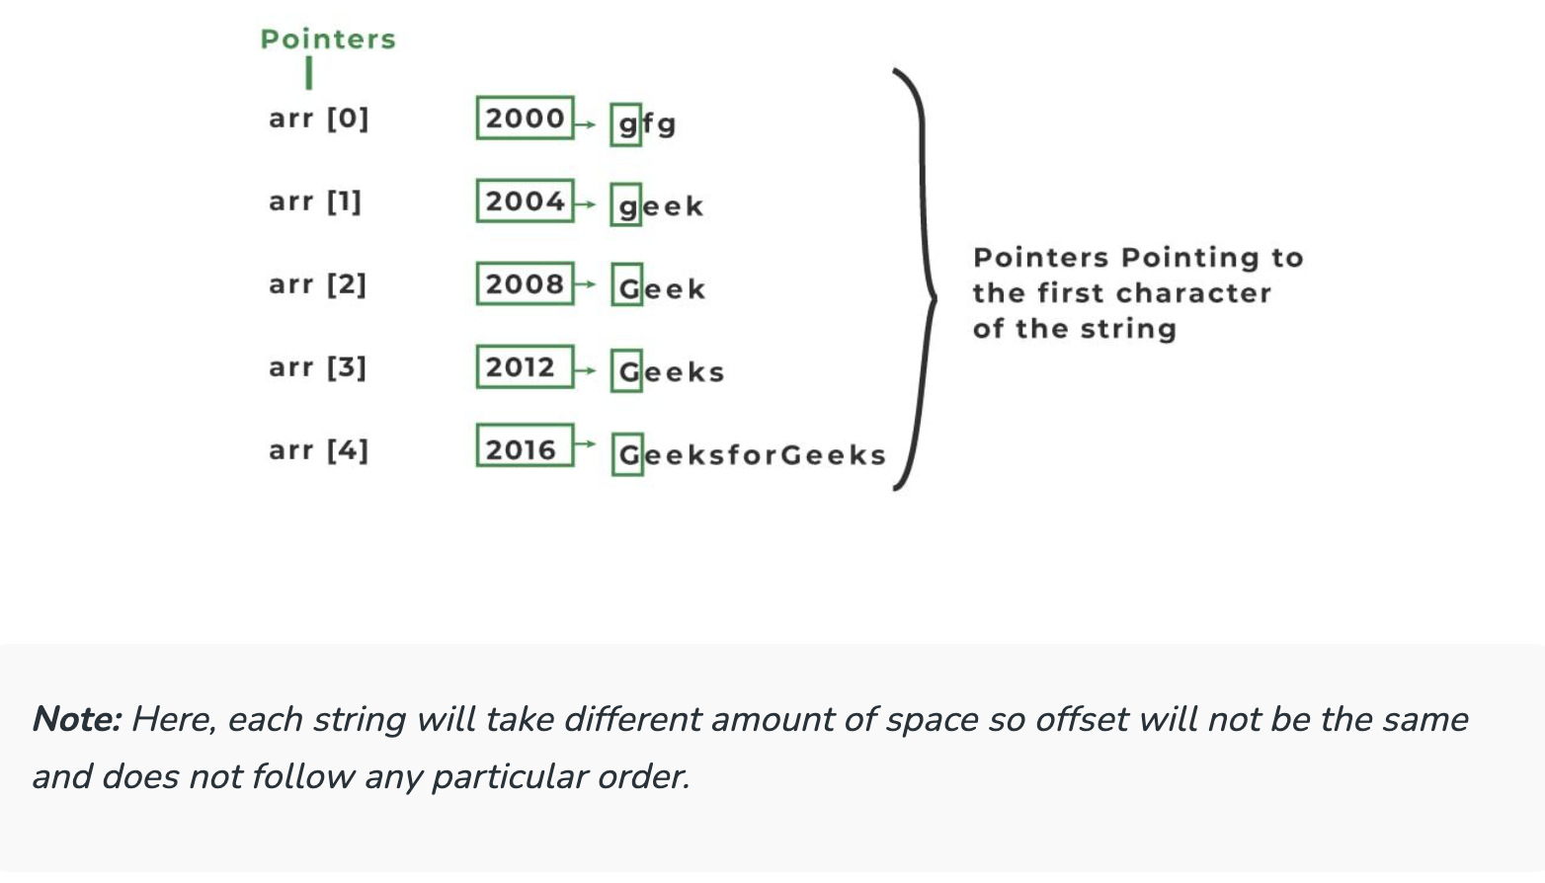
CSET333: Problem Solving Using C

